Slide 1
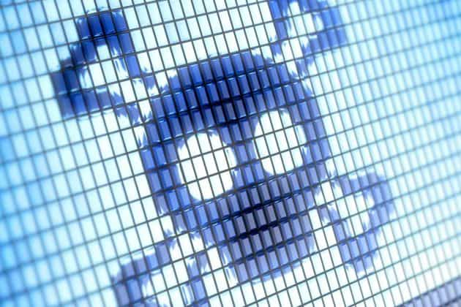
Killware
IST 623
December 8th, 2021
Group 5 Presentation
Noah Glory
Cassie Charles

Slide 2
Contents
Introduction of killware
Its Risks
2 in depth Case Studies
Low Sophistication: Oldsmar Water Facility
High Sophistication: Saudi Arabia petrochemical plant
Technologies
Existing Technologies
Future Impacts
Conclusion
Questions

Slide 3
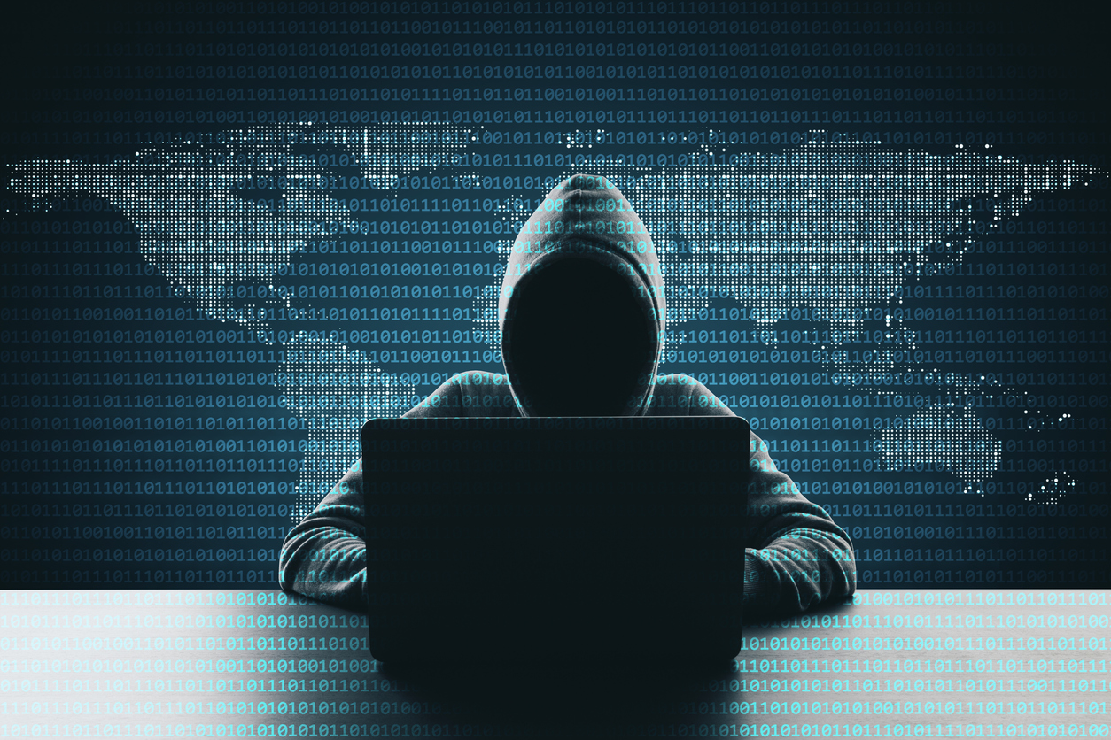
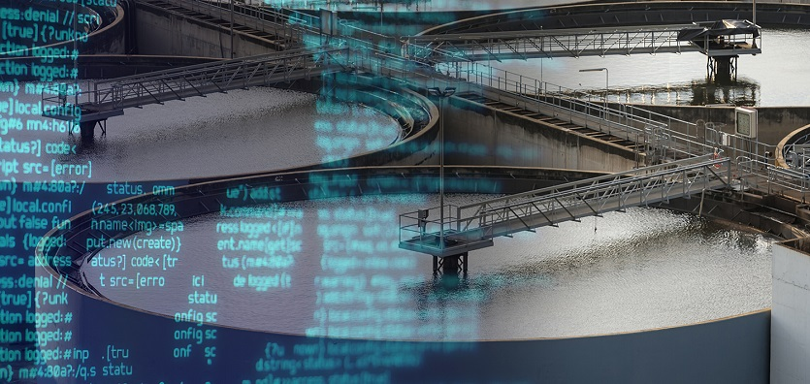
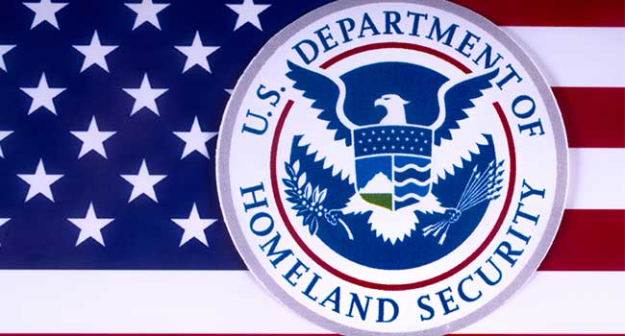
Introduction
What is Killware? Killware is different from other cyber security threats due to the main intention being to cause harm to people.
Can impact a broad range of industries Typically affects infrastructure among other sectors
Examples: Hospitals, water treatment facilities, police departments, energy facilities and transportation
Topic is gaining concern The head of the US department of homeland security recently came out and spoke about Killware’s potential hazards.

Slide 4
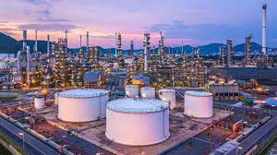
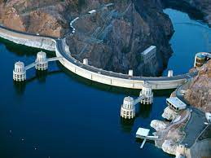
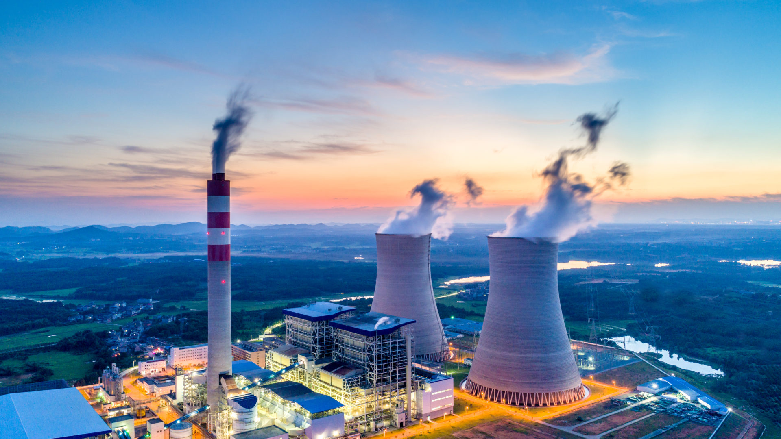
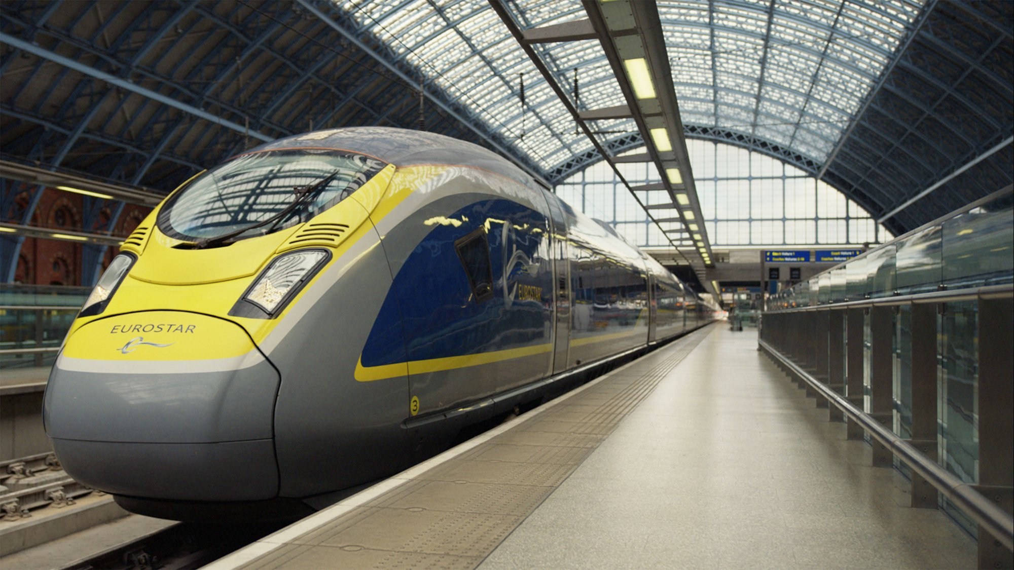
Potential Risks of Killware
Critical Infrastructure Sectors
Water treatment facilities
Manipulate chemical additions to poison drinking water
Energy Facilities
Cause major damage or explosions at plants
Hack power grids to stem needed energy production
Transportation
Disruptions to traffic signals and redirections of train routes
Military
Take control of weapon deployment systems
Gain access to military operations and plans
Dams
Redirect water flow to cause flooding
Other Sectors
Hospitals
Shut down facilities to prevent treatment to patients
Attacks on equipment and scheduling to alter surgeries and critical procedures
Manufacturing/Chemical Production Facilities
Disable safety instrumented systems to prevent facilities from shutting down during hazardous event
And I will turn it over to Cassie to talk about the first case study

Slide 5
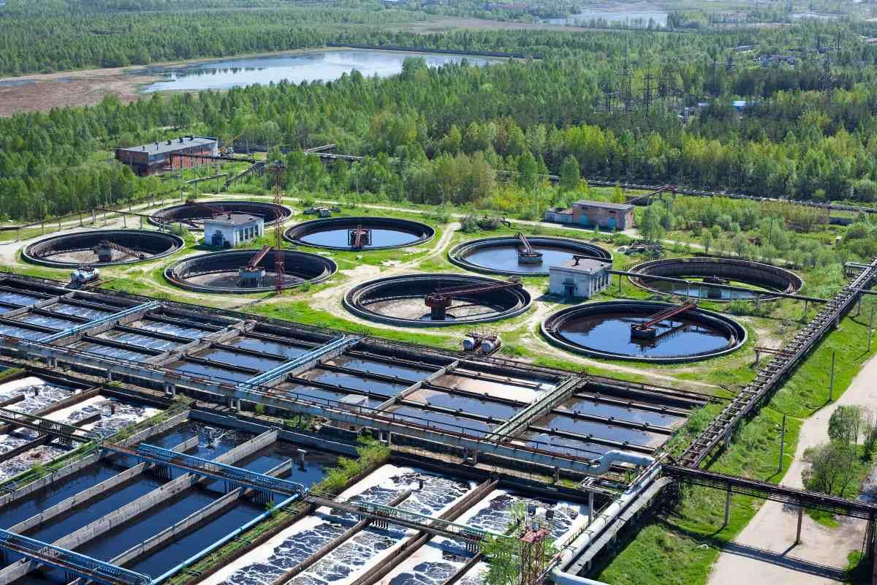
Oldsmar Water Facility
What happened?
What technology was used?
What was the outcome?
Attempt to alter the chemical makeup of the water that leads to Oldsmar, Florida

Slide 6
What Happened?
Remote Access
Sodium Hydroxide
Detection
Because of COVID and work-from-home, remote access was enabled.
TeamViewer was installed on the plant’s computers allowing managers to monitor and audit system behavior from home.
The attacker attempted to change the level of lye in the water.
In low levels, lye regulates the PH level of water
In high levels, lye is toxic
Attacker increased the levels by 100 times!
Someone happened to be looking at the computer screen.
An employee was watching the screen when the mouse moved, opened softwares, and manually increased the lye levels.

Slide 7
What Technology Was Used?
Unclear Method
Low Sophistication
Insecure Systems
While we know that the attacker access TeamViewer, it is not clear how. The likelihood is that they somehow accessed the login details of an authorized account.
Passwords are not a secure enough protection for such a highly important system.
The attacker clearly was not highly sophisticated in their computer knowledge because they didn’t hide their behavior on the computer.
They were not sophisticated in their system or water treatment knowledge because they increased the lye by too many factors to go unnoticed.
Remote access connections are incredibly dangerous and highly targeted because they are the only tools that connect the organization’s regular internet-connected IT network to the plant equipment.
When offline, the system not accessible from the outside world.
Notes:
Low sophistication: the attacker didn’t know that the system would have shut down anyway because the system would have automatically detected the dangerous levels of lye

Slide 8
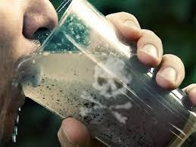


Outcome
While the remote access was a scary security failure, the system would have been automatically shut off anyway once it detected the chemical anomaly.
However, this problem is bigger than we would hope, with over 50k water treatment plants in the US. Water Infrastructure Act (2018) does not require plants to report compromises unless tainted water actually reaches the public, so we cannot know if this has happened before.
Dangers such as these need policy and regulations to stop bad actors from ignoring security risks.
Notes:
“Any facility where human lives are at risk, particularly so many, should monitor the industrial control process using artificial intelligence and anomaly detection to monitor, alert and stop anomalies within the process that aren’t a part of regular operations”

Slide 9
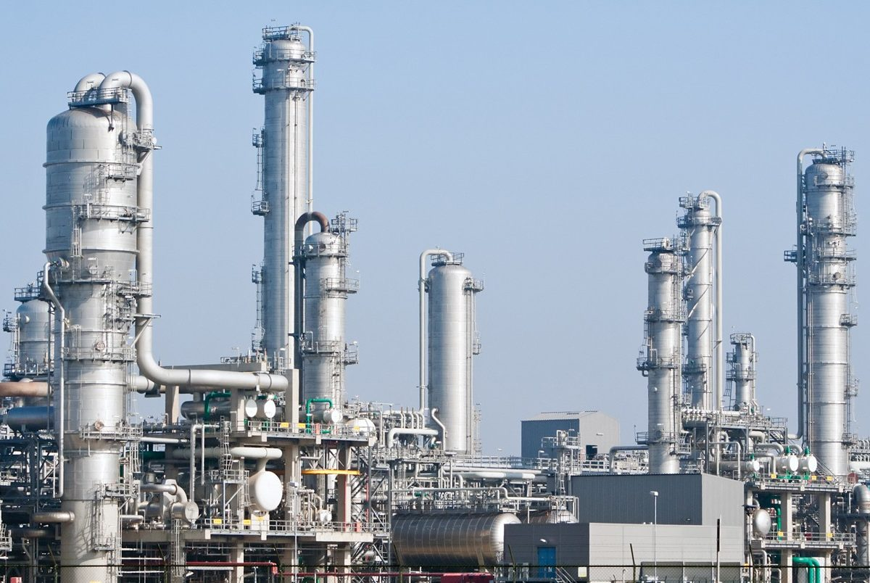
Petrochemical Plant
What happened?
Technologies Involved
Outcome and Concerns
Cyber attack on a Saudi oil and gas plant designed to cause an explosion

Slide 10
What Happened?
Detection
Triton Malware
Triton Malware
The industrial equipment randomly shuts down.
The attack was detected in August 2017 by employees , when the machinery at the plant began randomly shutting down during working hours.
This forces the entire facility to halt operations, causing immediate financial loss.
The shutdowns were traced to a file disguised a folder from Schneider Electric, the technology supplier for the plant.
A multi-part, ICS-tailored malware affected the industrial control systems.
Triton, or “Trisis”, malware was found in the file.
It was intended to cause the machinery to operate outside of its normal parameters until it suffered severe damage.

Slide 11
Technologies Involved
High Sophistication
Safety Instrumented Systems (SIS)
The time and resources deployed to develop the malware were extensive.
The component malware appears to have been custom-coded, with many of the coding indicators never having been seen before or used by any known hacking group.
Level of advanced technique points to a nation state being behind it.
Schneider’s Triconex controllers which ensure safe and regulated functions such as temperatures, voltage, and pressure.
Triconex controllers are used in about 18,000 industrial sites globally.
The Triconex system was previously viewed as one that required physical presence to access, known as a “lock and key operation.”
the Triconex systems had not been the victim of a remote attack.
Notes:
The malware itself malfunctioned due to an error the attackers had made in the code.
An especially alarming aspect of the attack is that it struck Schneider’s Triconex controllers

Slide 12
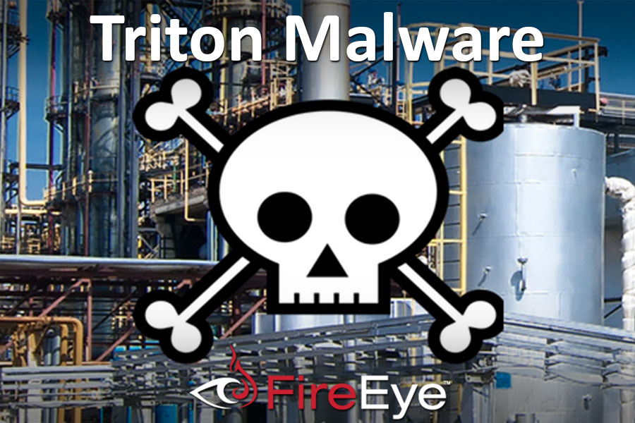
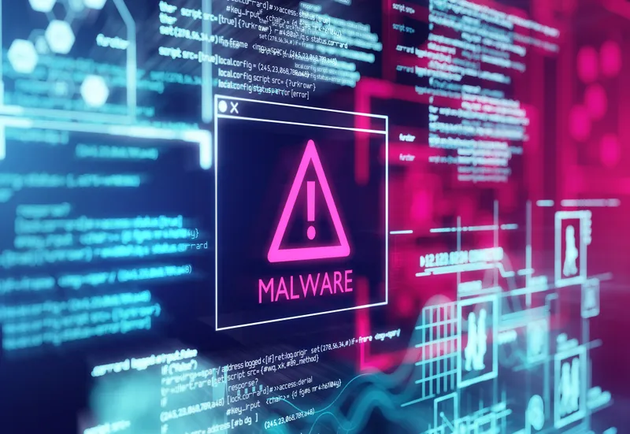
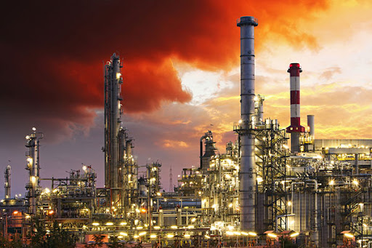
Outcome and Concerns
Because the use of Triconex equipment is so pervasive around the world, there are concerns that attackers could repeat their actions in thousands of industrial locations around the world.
This time, the goal of the attackers was to cause an explosion, take human life, and wreak devastation on equipment.
The writers of the malware made a mistake in configuration of the code causing the attack to fail.
But given that the attackers have almost certainly fixed their code error by now, the world at large is still in peril from these kinds of attacks and ICS vulnerabilities remain abroad and in the U.S.
Notes:
· Investigators say they are concerned that the Triconex controllers are used in about 18,000 plants around the world, including nuclear and water treatment facilities, oil and gas refineries, and chemical plants. Triconex was supposed to be isolated from remote configuration, and although researchers believe the attack was not an inside job, they have not revealed how the system was infiltrated.
· Investigators say they are concerned that the Triconex controllers are used in about 18,000 plants around the world, including nuclear and water treatment facilities, oil and gas refineries, and chemical plants. Triconex was supposed to be isolated from remote configuration, and although researchers believe the attack was not an inside job, they have not revealed how the system was infiltrated.

Slide 13
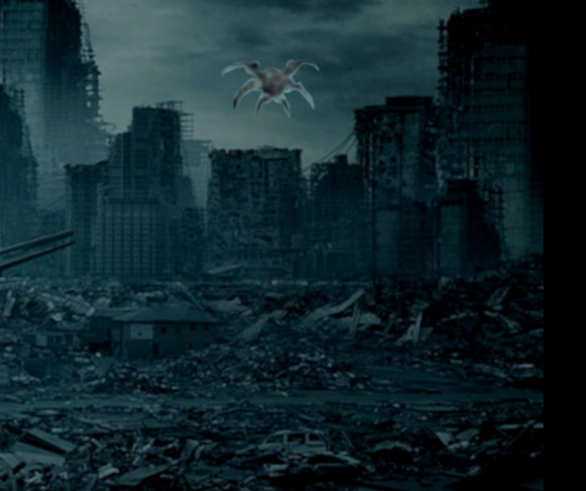
It is a malice software
Killware Technologies
Attempt to kill people or cause great harm to society

Slide 14
Killware Sophistication
Low
Medium
High
Cookie theft
Eavesdropping
Keylogger
Insecure software
Phishing
Fake WAP
Denial of Service
Bait and Switch
Virus
Trojan
Waterhole attacks

Slide 15
What Happened in Our Cases
Oldsmar water facility
Saudi oil and gas
Triton Malware
Insecure applications (Low Sophistication)
The likelihood is that they somehow accessed the login details of an authorized account.
Passwords are not a secure enough protection for such a highly important system. The passwords could be obtained by simple technique, i.e. eavesdropping. Intruder gains access with the compromised credentials to maliciously increase the chemical levels at the water treatment facility.
Malware/Virus (High Sophistication)
Triton is malware that can disable safety instrumented systems, which can then contribute to a plant disaster. The time and resources deployed to develop the malware were extensive. Level of advanced technique points to a nation state being behind it. The malware most likely came from the Central Scientific Research Institute of Chemistry and Mechanics (CNIIHM), a research entity in Russia.

Slide 16
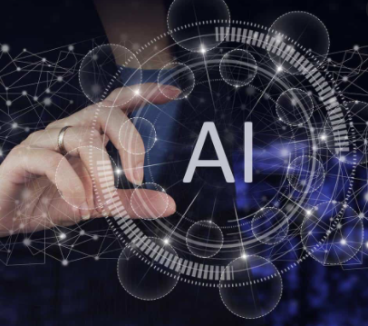
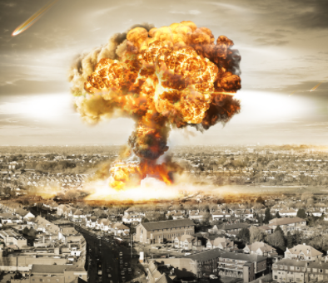
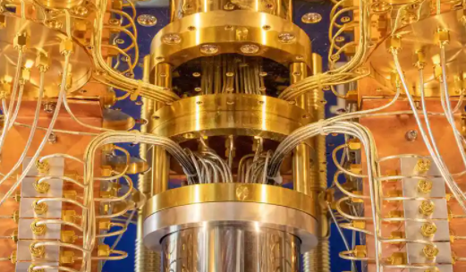
Future Technologies
Artificial Intelligence
Malware controlled by artificial intelligence could create more convincing spam, avoid security detection, and better adapt itself to each target.
Quantum Key Cracking
Using quantum computer can be used to crack keys when it becomes much more capable. Many traditional cryptographic methods will no longer be secure with key lengths considered to be strong today.
Nation State Hacker
A hacker or group of hackers working with an adversarial government that commits acts of cybercrime against the U.S. or its allies. They can use most technologies available by that nation.

Slide 17
Future Impacts
Overall Impacts
Future Threats
Gartner Inc. press release:
“By 2025, cyber attackers will have weaponized operational technology environments to successfully harm or kill humans.”
Another comment
“The financial impact of CPS attacks resulting in fatal casualties will reach over $50 billion by 2023”
These statements are alarming considering there only a few years away.
Increase in targeting critical infrastructure
“Despite the increasing digitization, most sectors still rely heavily on legacy systems.”-Tripwire
These sectors need to look at improving their security
Autonomous vehicles with them becoming more common
On comparing a computer vs. vehicle hack: “The level of risk is very different: one is stationary, while the other can weigh around two tonnes and travel at speeds in excess of 70mph… in light of the potential profit and harm that can be done by such hacks, the motivation to attempt them likely will continue.”Automotive World
Detection

Slide 18
Conclusions
Killware is an increasing security threat which can cause devastating consequences
It can impact a broad range of industries including critical infrastructure sectors
There have already been recent attacks
Oldsmar water facility – Where an attemp to add chemicals to drinking water occurred.
Saudi Arabia petrochemical plant – Where we saw machinery at the plant shut down
Killware uses various technologies for attacks with different levels of sophistication
Finally, killware threats are predicted to increase dramatically in the near future

Slide 19
Questions?

Slide 20
Bibliography
Gartner Predicts By 2025 Cyber Attackers Will Have Weaponized Operational Technology Environments to Successfully Harm or Kill Humans- Gartner Inc.
U.S. Critical Infrastructure: Addressing Cyber Threats and the Importance of Prevention- TripWire
Autonomous cars low on a hacker’s hit list, for now- Automotive World
Cyber attack on Saudi plant designed to cause explosion - ITP.net - ITP
Trisis has the security world spooked, stumped and searching for answers (cyberscoop.com) - Cyberscoop
A Cyberattack in Saudi Arabia Had a Deadly Goal. Experts Fear Another Try. - The New York Times
A cyber attack in Saudi Arabia failed to cause carnage, but the next attempt could be deadly - Independent
Hack of Saudi Petrochemical Plant Was Coordinated From Russian Institute - The New York Times
https://fossbytes.com/hacking-techniques/ - Fossbytes
https://en.wikipedia.org/wiki/Triton_(malware) - Wikipedia
https://www.techrepublic.com/article/how-ai-enhanced-malware-poses-a-threat-to-your-organization/ - Techrepublic

